Slide 1
Netflix Data Analysis Using POWERBI
Presented by Shaik Arshiya Fathima

Slide 2
Data Cleaning in Excel
I just done the basic data cleaning in excel like, adding filter to both of the tables and added colors to the column, and i deleted the blank spaces for the particular columns, i have ensure the ratings properly and format the date

Slide 3
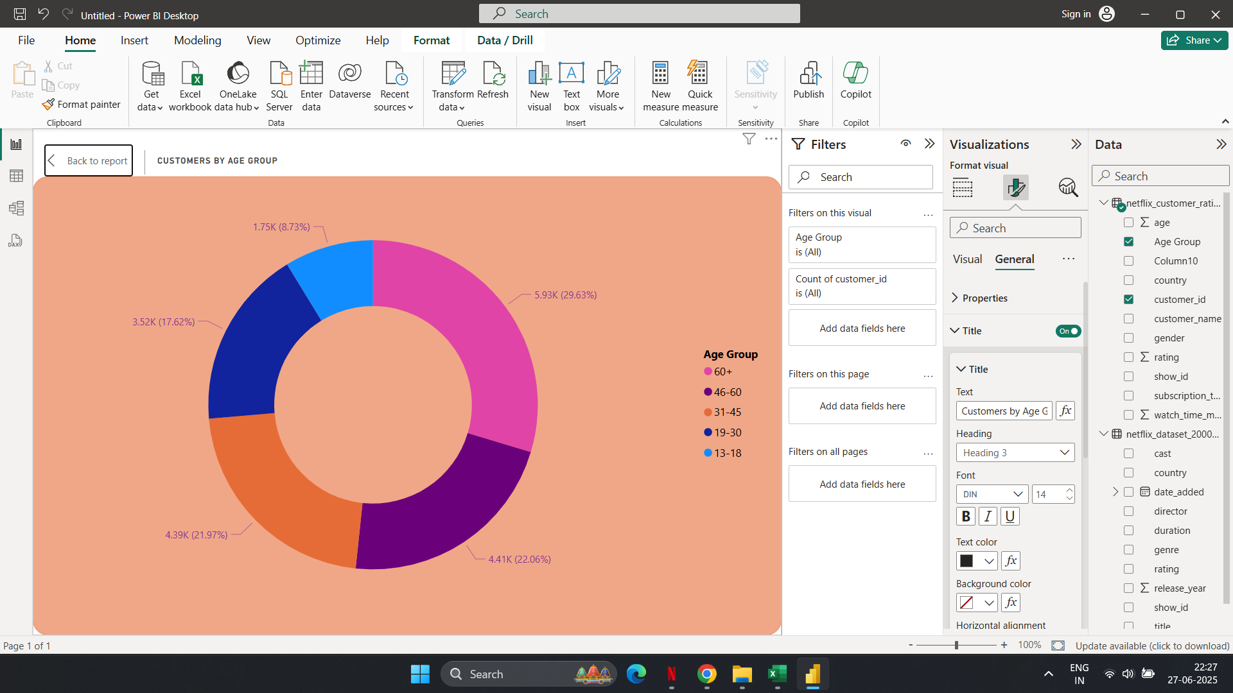
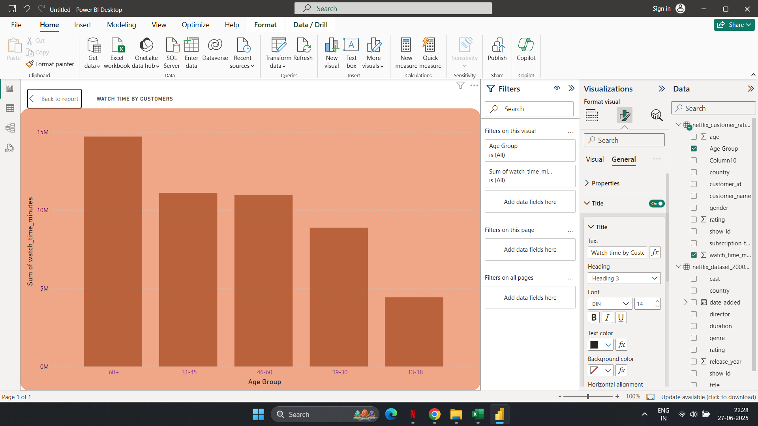
1.Customer Demographics Analysis
In this i have two types of charts i.e; Customer Distribution by Age Group and Watch Time by Age Group

Slide 4
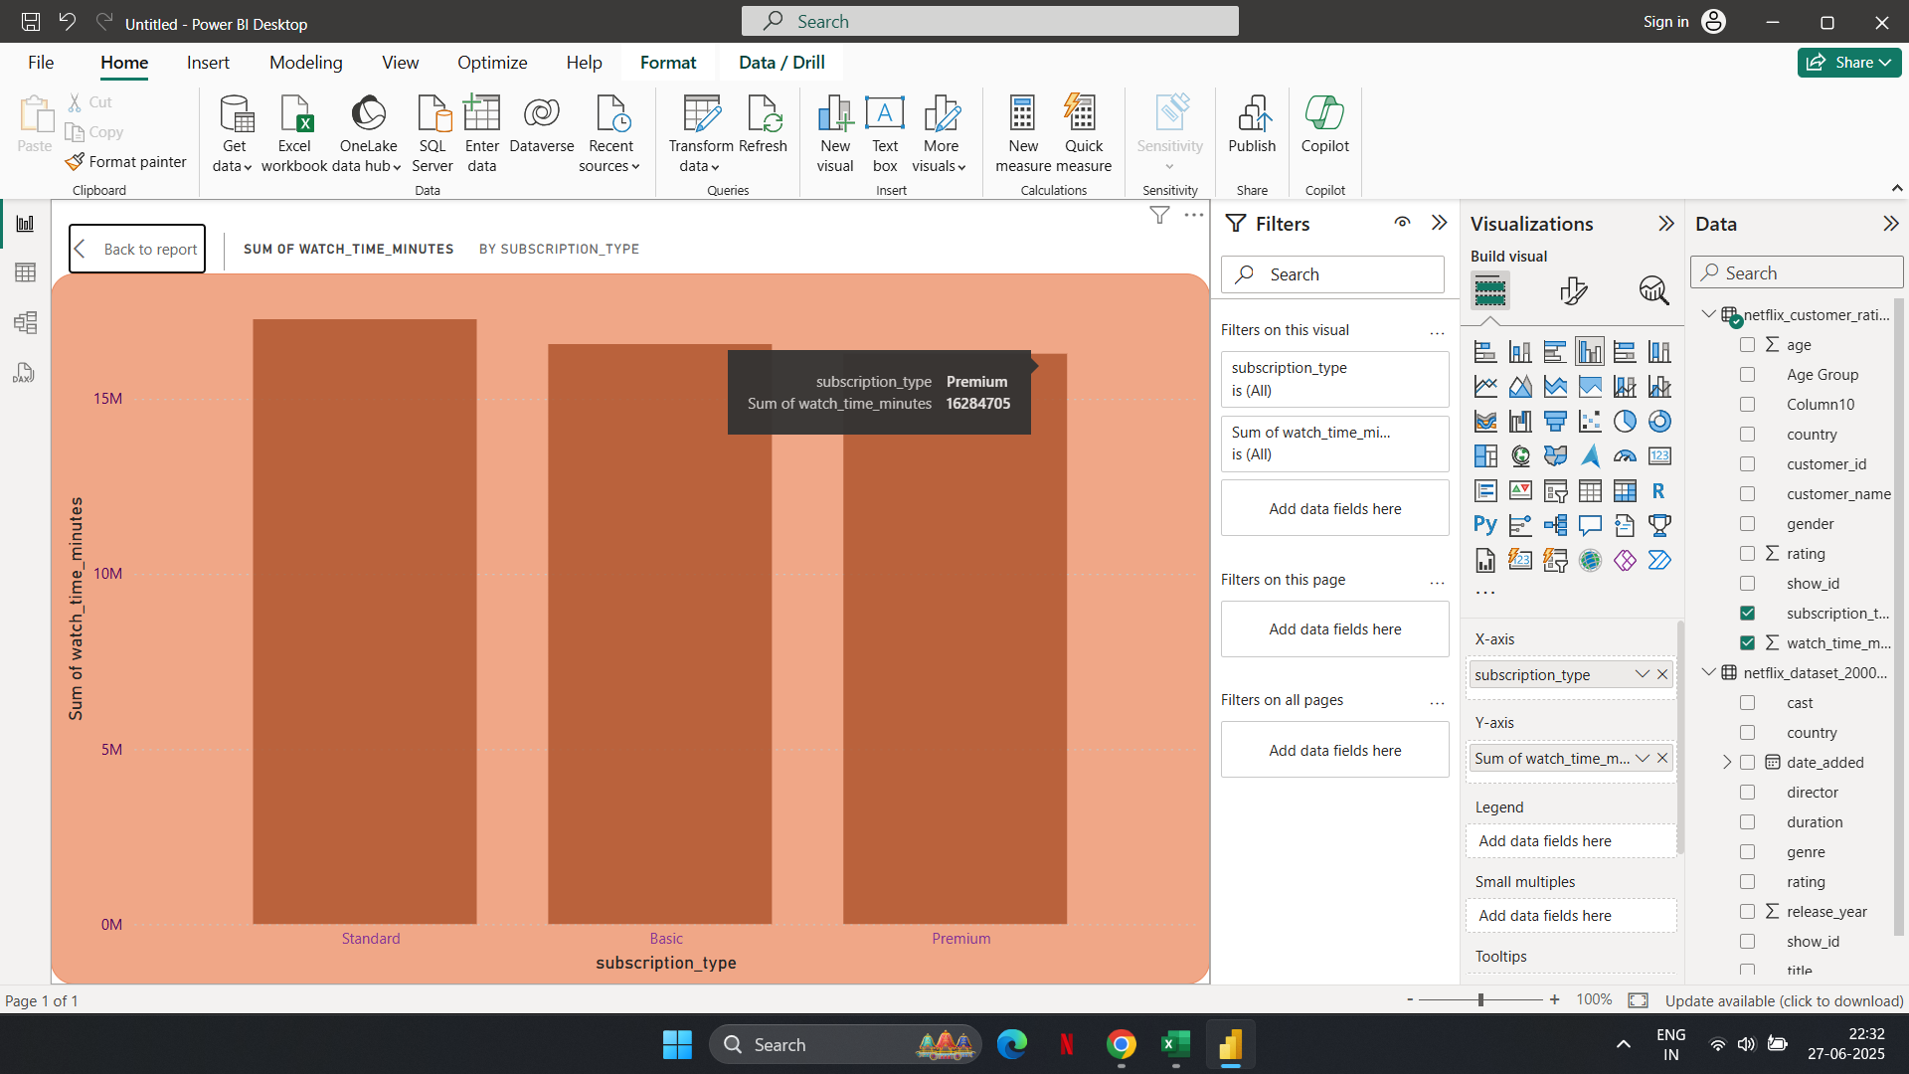
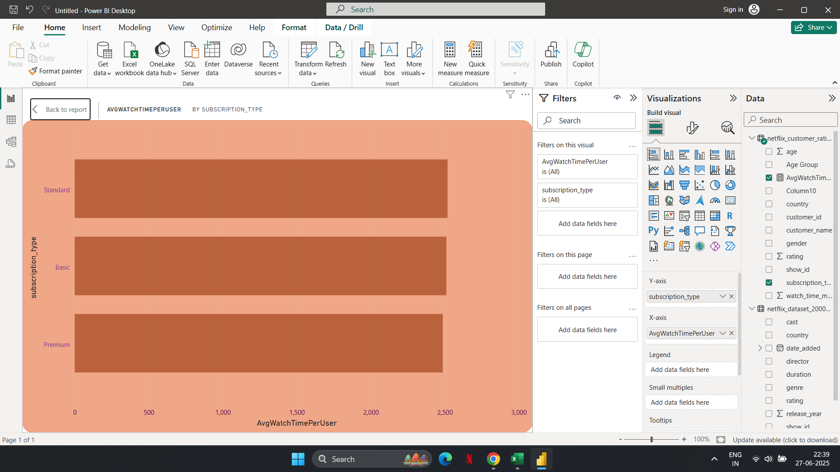
2.Subscription Type vs. Watch Time
In this the STANDARD subscription type is holding max in both highest engagement and watch time.

Slide 5
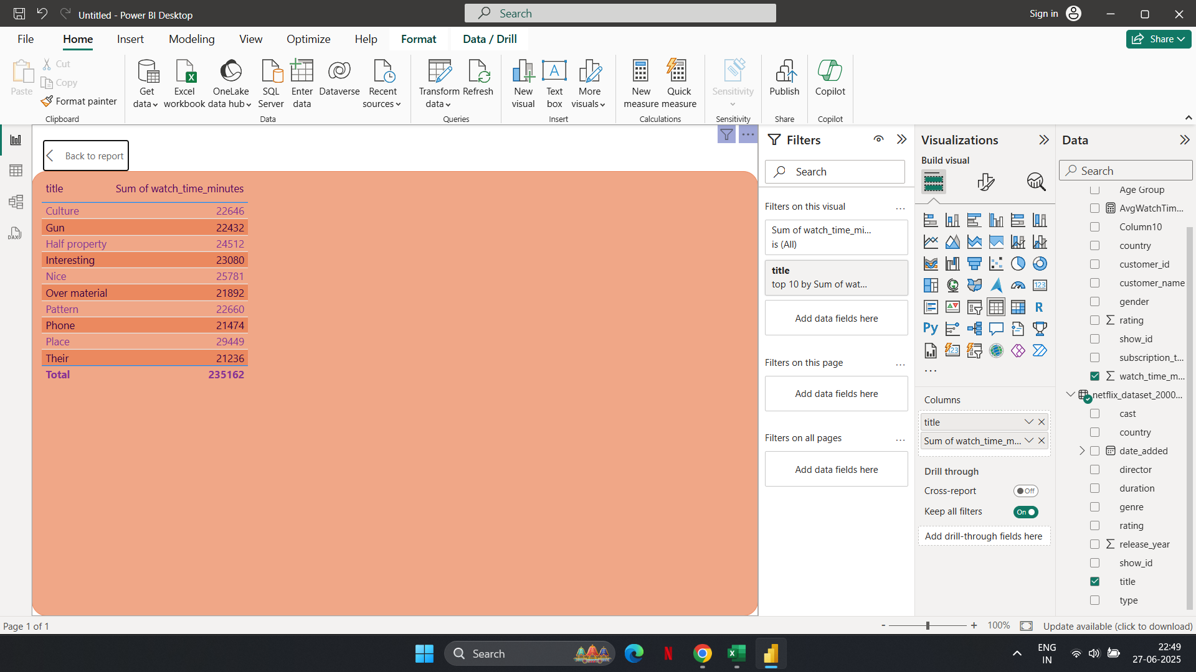
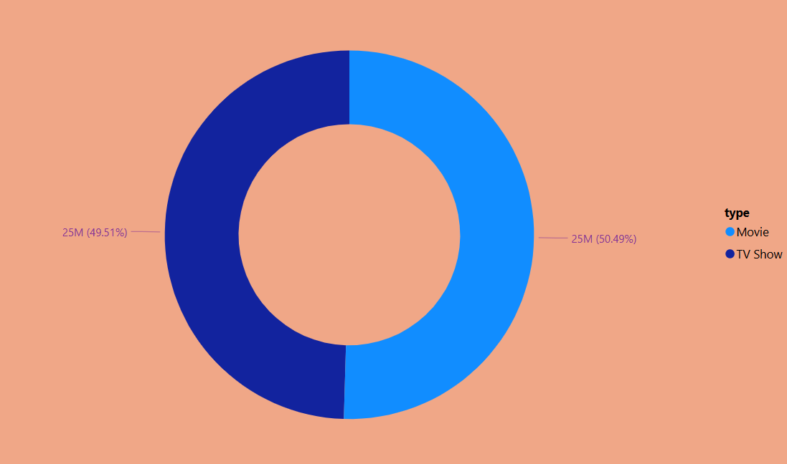
3.Descriptive and Comparative Analysis
These are the top 10 most watched netflix titles.

Slide 6
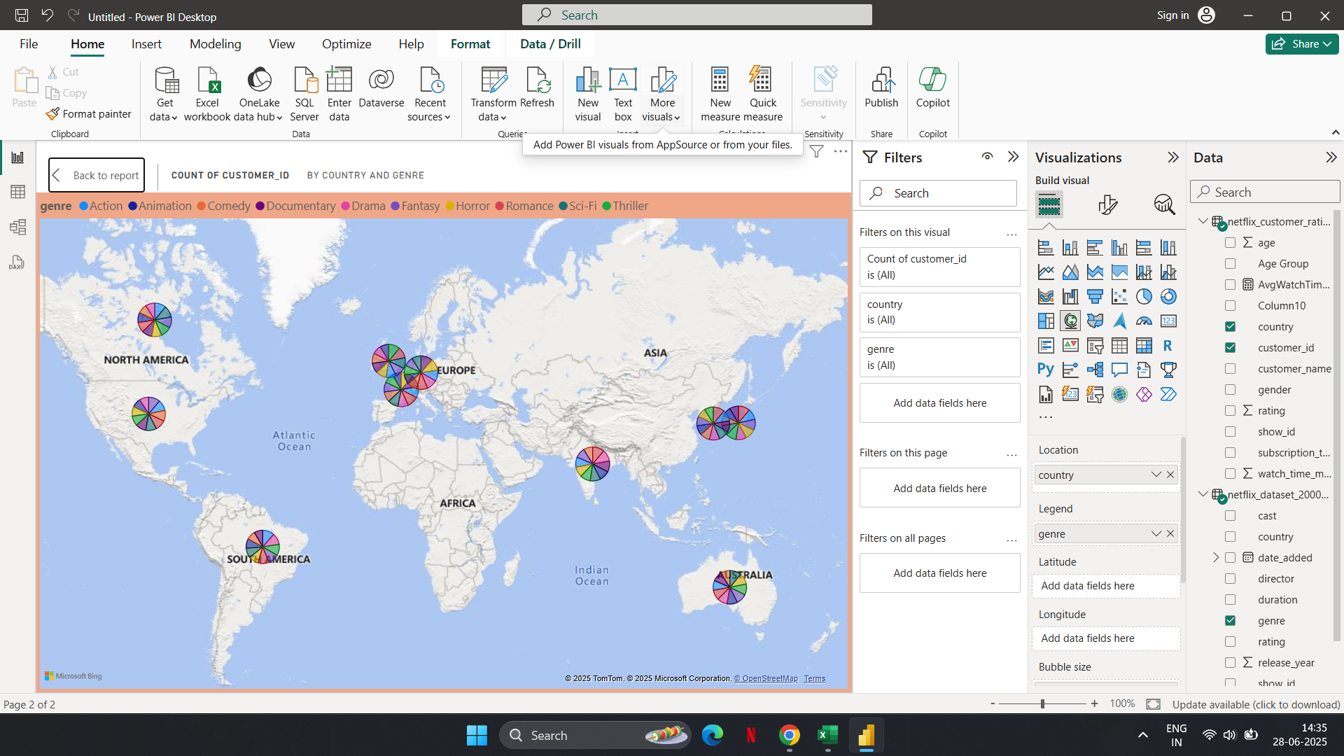
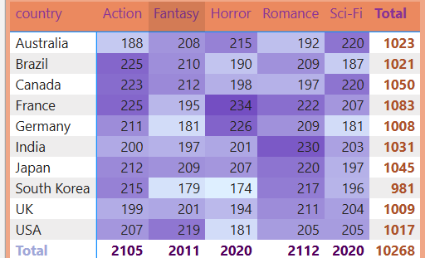
4.Genre Popularity by Country
As per the total no.of viewers, these are the genres watched by customers per country.

Slide 7
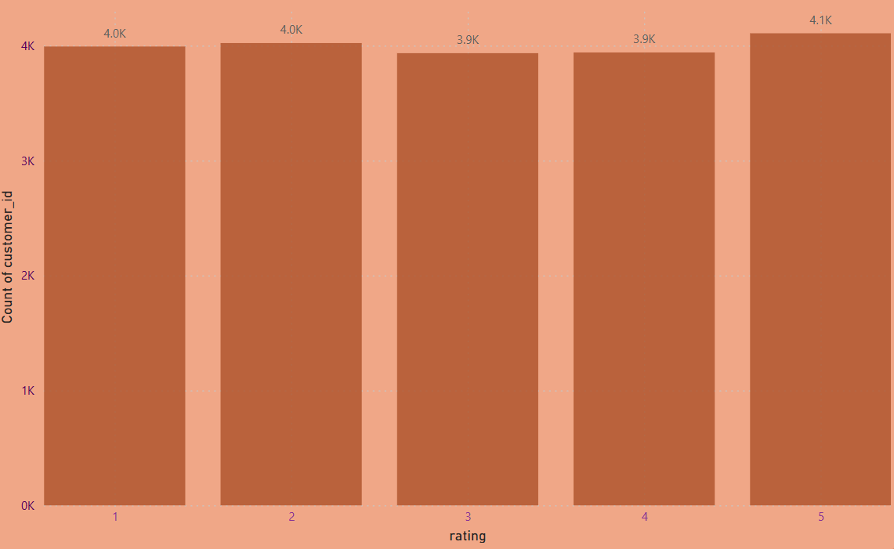
5.Customer Ratings Distribution
TV-Y7 has the highest number of user interactions (2,124 users), indicating high engagement for children/family-friendly content. G and TV-Y also have strong engagement. Ratings like TV-14, R, and PG-13 have relatively lower engagement, though still significant. Mature content (TV-MA) sees almost equal user activity to family-safe categories.

Slide 8
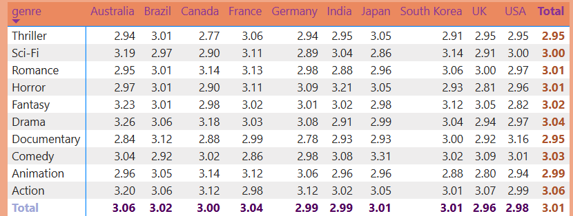
5.Customer Ratings Distribution
They said that Find the average rating per genre and per country. So by using dax i have merged both genre and country in one chart.

Slide 9
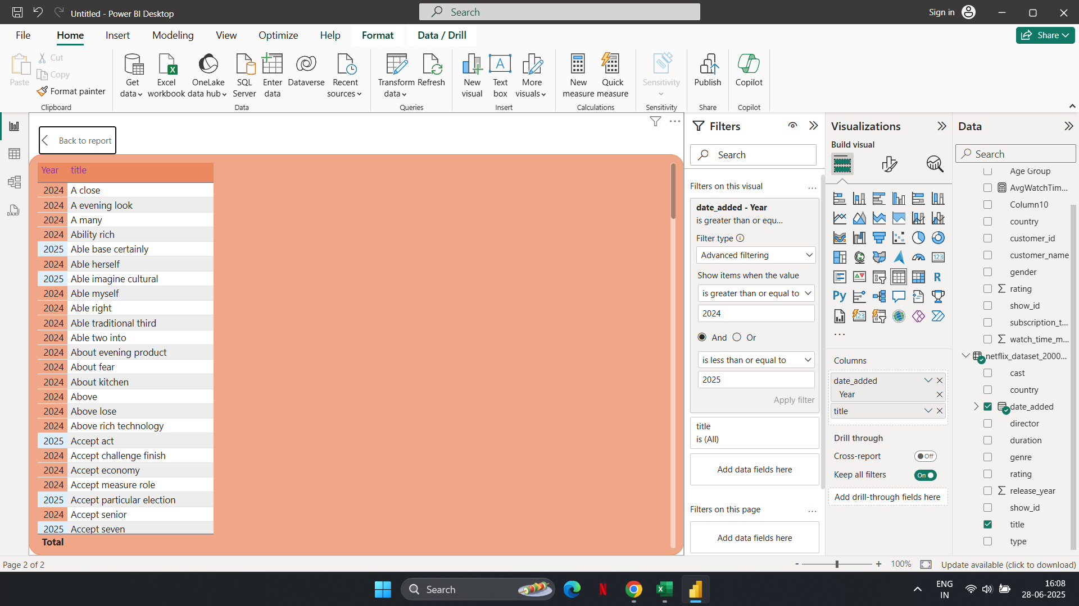
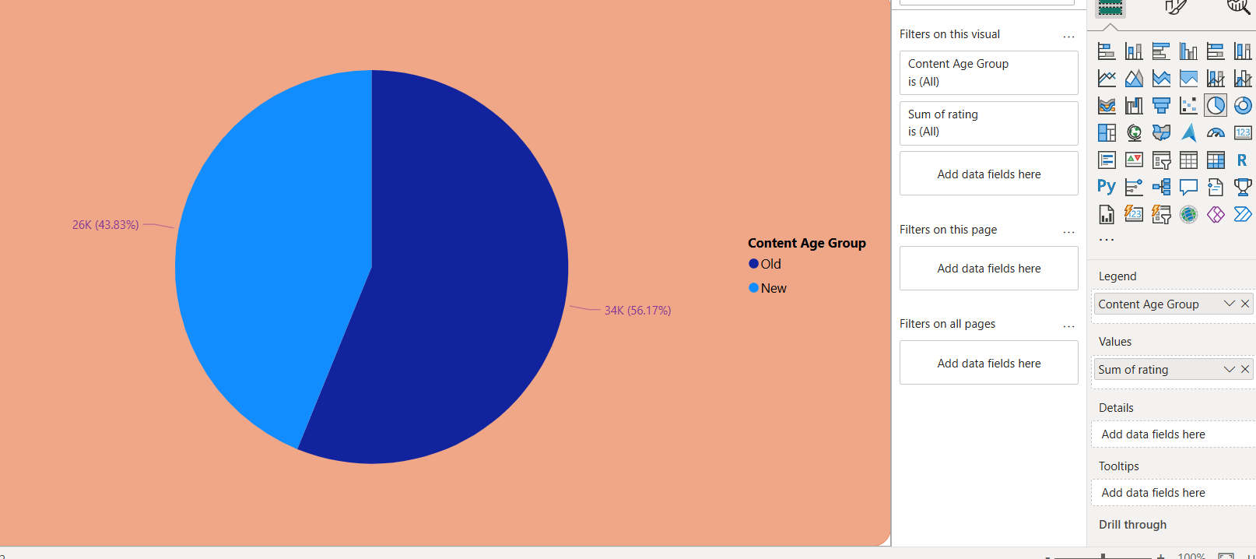
6.Trending Content Analysis
They said that Find the average rating per genre and per country. So by using dax i have merged both genre and country in one chart.

Slide 10
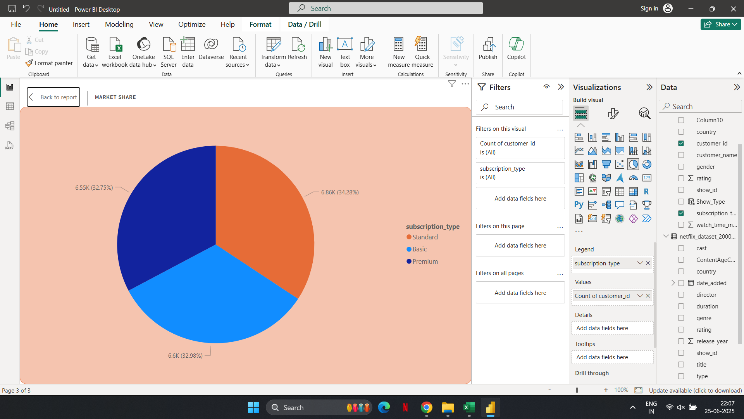
8.Market Insights & Revenue Analysis
This shows the market share percentage of each subscription type.

Slide 11
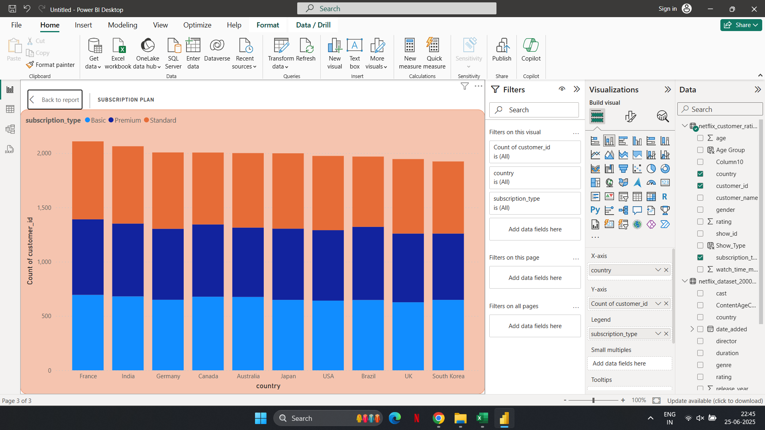
8.Market Insights & Revenue Analysis
This shows the subscription plan of different countries..

Slide 12
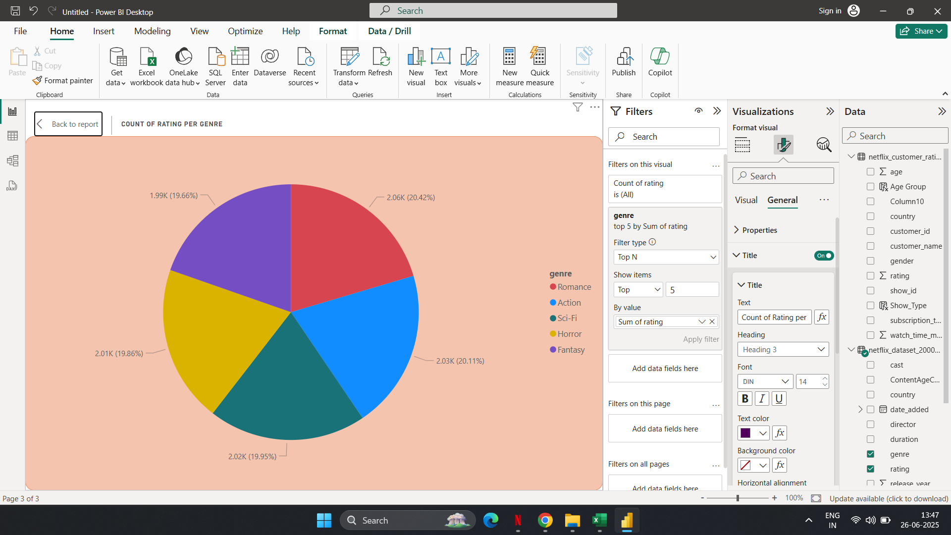
10.High-Rated vs. Low-Rated Content
Romance is holding the highest rating with the percentage of 20.42 and the lowest is Fantasy with the percentage of 19.66..

Slide 13
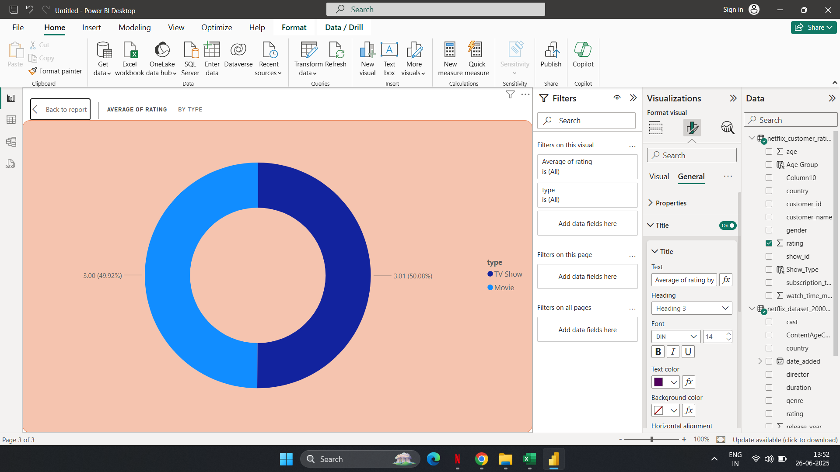
10.High-Rated vs. Low-Rated Content
The difference in average rating between TV Shows and Movies is very small (just 0.01). This suggests that viewers rate both types almost equally, with a very slight preference towards TV Shows.

Slide 14
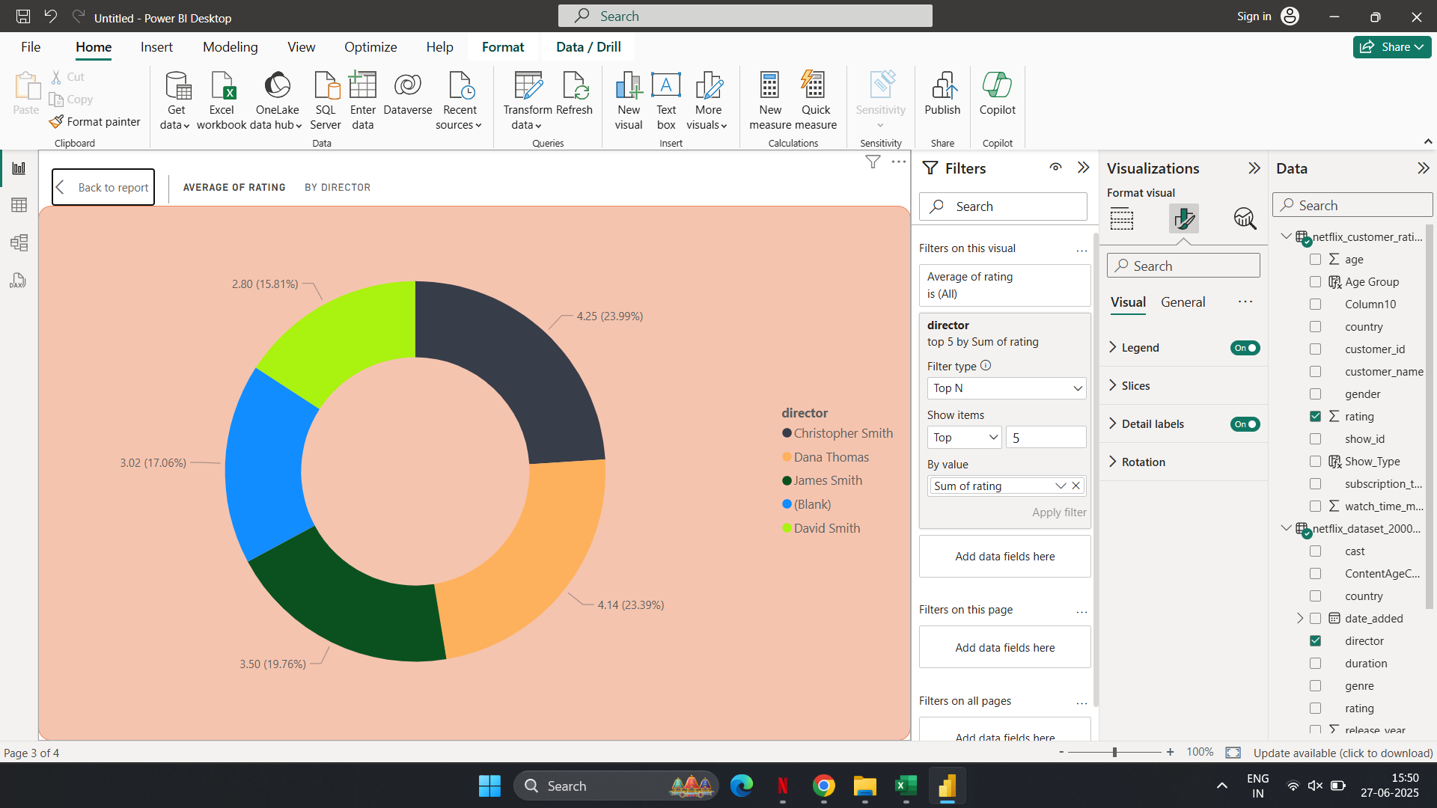
11.Director & Cast Influence on Ratings
This chart shows the top 5 directors of their ratings.

Slide 15
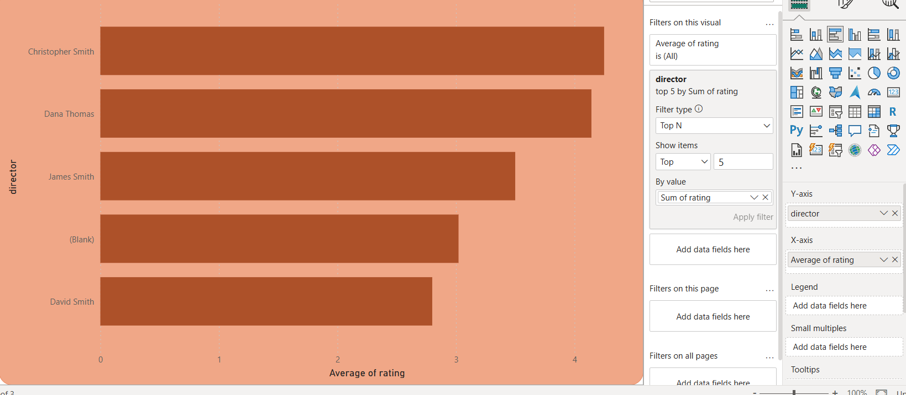
11.Director & Cast Influence on Ratings
This chart shows the top 10 countries by their ratings.

Slide 16
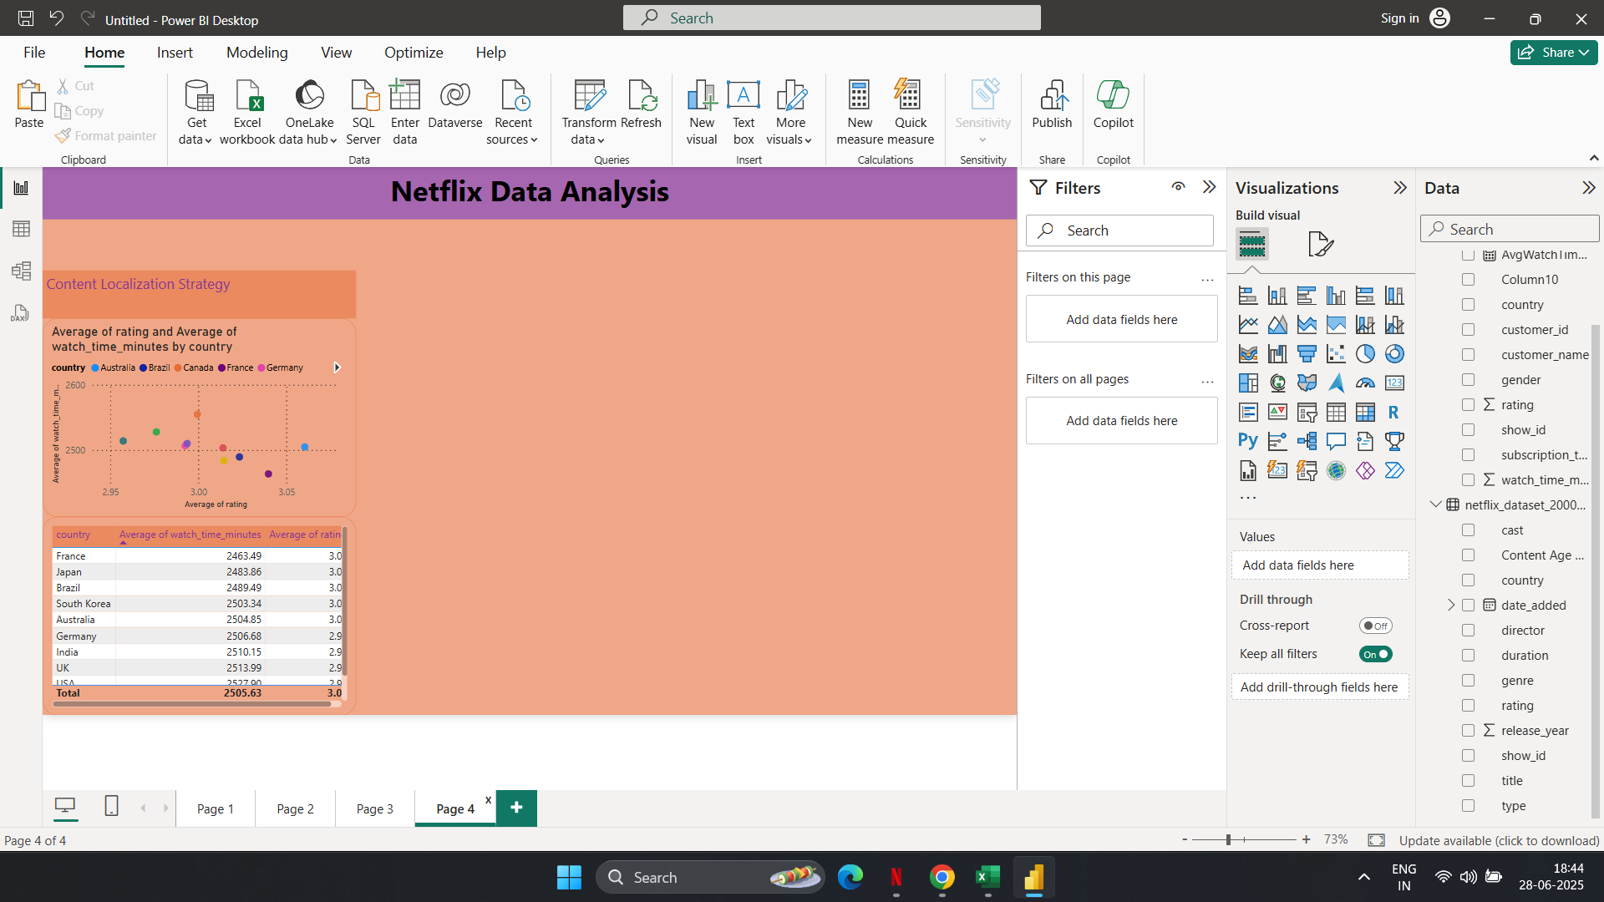
12.Content Localization Strategy
This chart shows the low to high performing countries.

Slide 17
12.Content Localization Strategy
The Content Strategies are:
1. Low Engagement + Low Rating
Introduce local storytelling
Include regional languages
Diversify genre offerings
2. Low Engagement but High Ratings
Boost platform visibility
Release new seasons faster
3. High Engagement but Low Ratings
Refine content quality
Interactive feedback loops
AI-powered personalized content feeds to reduce irrelevant content
Country | Issue | Suggested Strategy
India | Low Rating + Avg. Engagement | Add more regional content (Telugu, Tamil, Marathi), focus on family dramas, comedy
Germany | Low Engagement | Localize UI, promote through German influencers, focus on high-rated dubbed content
Japan | Low Rating | Enhance anime quality, more localized romantic or tech-thrillers
France | Low Engagement | Feature strong European co-productions, push subtitles & dubbing
Brazil | Low Rating | Improve dubbed content quality, promote content with cultural relevance

Slide 18
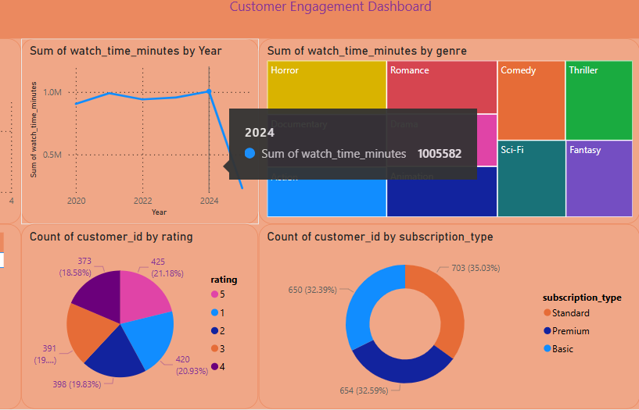
Customer Engagement Dashboard

Slide 19
Customer Engagement Dashboard
If Netflix had a competitor with different content strategies, what improvements should Netflix make based on user preferences?
Localize More Strategically
Target the 19–30 & 31–45 Age Groups
Optimize Subscription Strategy
Time New Releases Wisely
Elevate Director & Cast Influence
Use Data-Driven Content Feedback

Slide 20
Recommendations
Content & Viewer Preferences
Older audiences (60+) form the largest viewer group (29.63%). ➤ Recommendation: Increase content targeting this demographic (e.g., drama, classics).
Romance, Drama, and Thriller are the most-watched genres by total watch time. ➤ Recommendation: Prioritize production and promotion of these genres globally.
TV Shows slightly outperform Movies in terms of watch time (50.49% vs. 49.51%). ➤ Recommendation: Maintain a healthy mix, but invest more in serialized content.
Subscription Insights
All three subscription tiers (Basic, Standard, Premium) have nearly equal market share, ~33% each. ➤ Recommendation: Introduce tier-specific content or loyalty perks to differentiate plans.
Standard plan users have the highest average watch time per user. ➤ Recommendation: Focus retention efforts on Standard users; consider them high-value.
Subscription dominance varies by country, e.g., Premium is preferred in some while Basic dominates in others. ➤ Recommendation: Localize subscription strategies based on regional usage.

Slide 21
Recommendations
Geographic & Genre Trends
Genre preferences vary by country:
Canada, UK → Sci-Fi
Germany, Brazil → Action & Romance ➤ Recommendation: Tailor genre recommendations and marketing regionally.
Netflix is underperforming in France (lowest engagement & rating). ➤ Recommendation: Local content partnerships or better dubbing/subtitles may help.
Top 5 directors (e.g., David Smith, Dana Thomas) have higher average ratings. ➤ Recommendation: Invest in collaborations with top-performing directors.
Rating & Retention Trends
Most ratings cluster around 3–5 stars, with 5 stars having slightly higher count. ➤ Recommendation: Maintain quality consistency and actively gather user feedback.
Higher watch time tends to correlate with higher ratings. ➤ Recommendation: Encourage binge-worthy content and personalized recommendations.
Recently added content (2024–2025) dominates watch time. ➤ Recommendation: Keep refreshing the library with new releases regularly.
Release Timing Strategy
Peak content additions occurred in early to mid months (Jan–June). ➤ Recommendation: Schedule major releases around this time for maximum engagement.
Content released in certain months yields slightly better ratings. ➤ Recommendation: Analyze monthly performance deeper for optimal launch timing.

